Slide 1
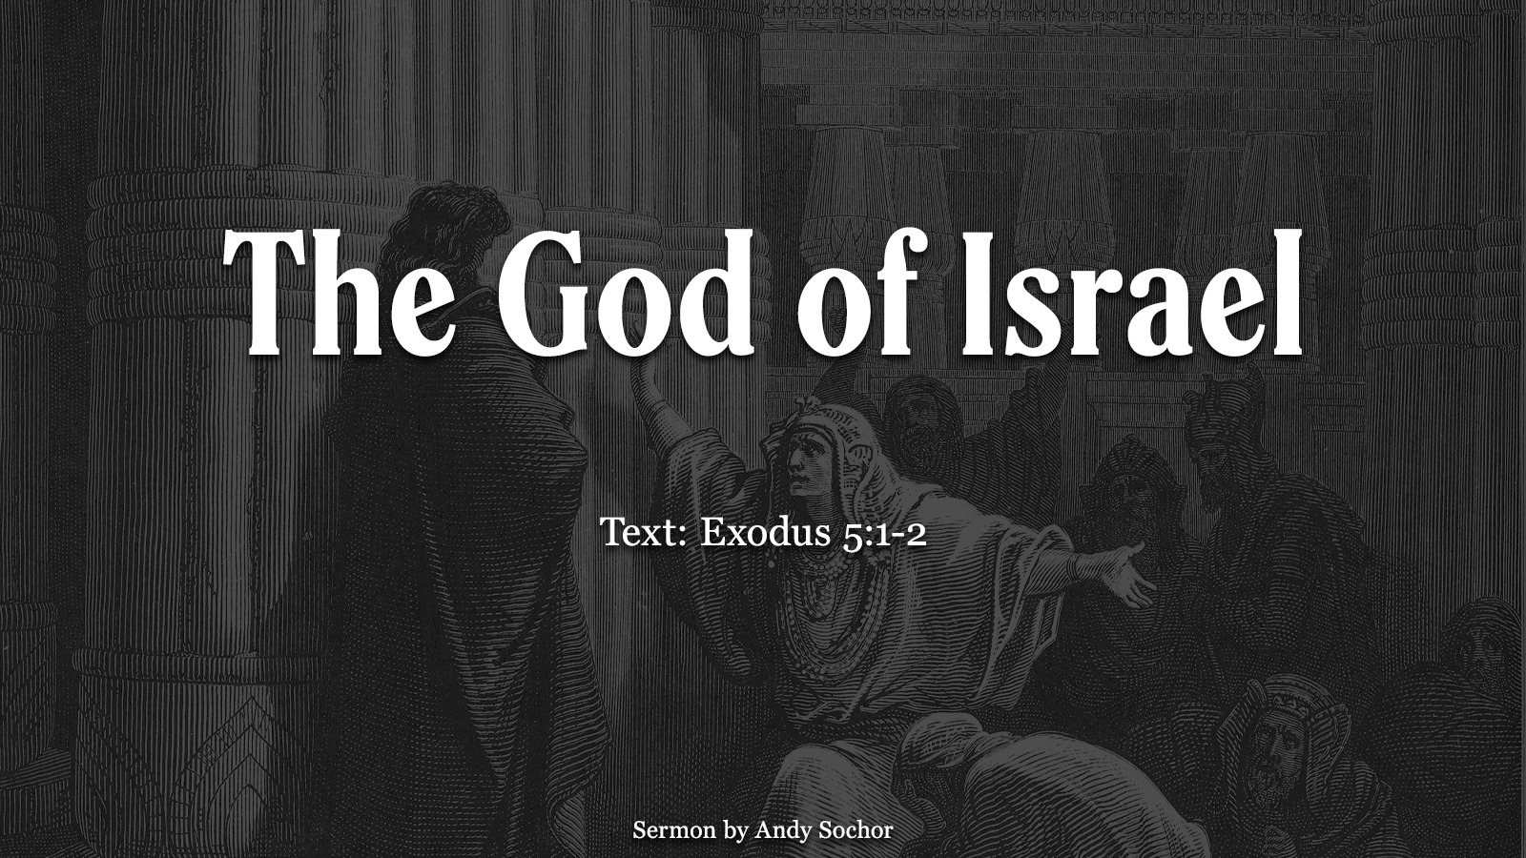

Slide 2
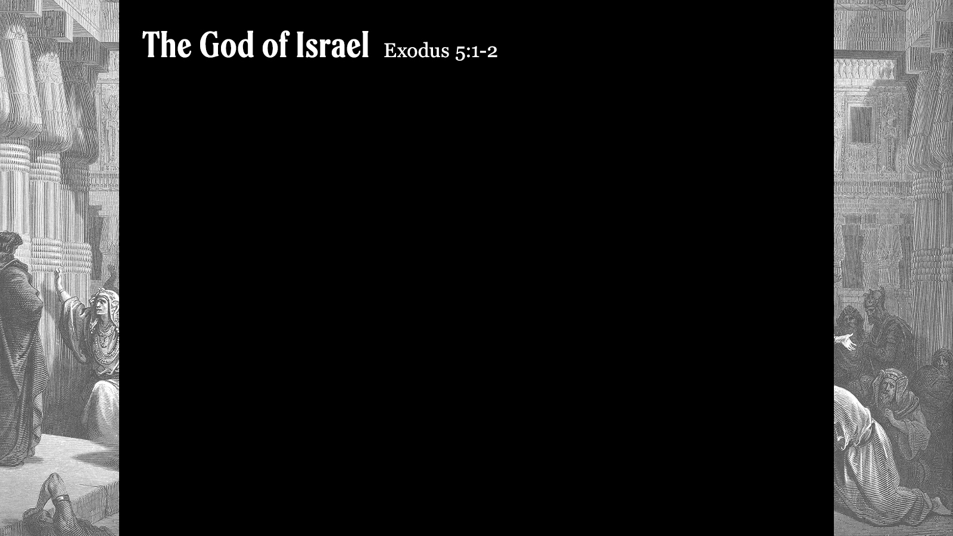
Background of the Ancient World
Idolatry was common
  God called Abraham to leave his family (Gen. 12:1) – including the “gods” they served (Josh. 24:2)
  Jacob’s father-in-law had “household idols” (Gen. 31:19)
  The Egyptians served many “gods” (Ex. 12:12)
  Joshua challenged the people to put away all foreign “gods” (Josh. 24:14-15)
These “gods” were thought to help with harvests, fertility, battles, etc. – all of these blessings could be found in God, but people settled for an inferior imitation

Slide 3
The God of Israel Was Different
The “gods” of the people were created by them (Is. 37:18-19) – people failed to see the absurdity of worshipping a “god” they created (Is. 44:12-19)
The God of Israel was real (Ex. 15:11; 18:10-11; Jer. 10:10; 1 Th. 1:9)
God proved this over and over – by delivering His people from Egypt (Ex. 14:13-14; 15:1, 11); by destroying Jericho (Josh. 6:1-2) and in the conquest of Canaan (Josh. 21:43-45); in the contest at Mount Carmel (1 Kings 18:20-24, 36-38)
It was undeniable to all observers – to the Egyptian people (Ex. 12:33); to Rahab (Josh. 2:9-11); to the undecided Israelites (1 Kings 18:39)

Slide 4
God Promised to Bless Israel
He would bless them because of His covenant (Deut. 7:6-9)
These blessings were conditioned upon their obedience (Deut. 7:9-11; 28:1-2, 14)
They eventually went into captivity due to their sin (Lev. 20:22; Deut. 28:64) – first Israel (2 Kings 17:6-8, 18); then Judah (2 Kings 24:2-3; 25:10-11)

Slide 5
Why Did God Bless Israel?
Despite their sin, He preserved a remnant (Jer. 23:3-6) – this was part of His promise to Abraham (Gen. 12:1-3), especially the SEED promise
God’s plan was to bring Christ into the world (Acts 3:25-26) – this was to bless the nations (Mt. 4:15-16; 28:19-20); ultimately, it was done to save us (Gal. 4:4-5; 3:26-29)

